Slide 1

6th Grade Accelerated Math
Unit 3, Lesson 5 Rational Numbers in Real-World Context Volume 1, pg. 98

Slide 2


Benchmark
MA.6.NSO.1.1
Extend previous understanding of numbers to define rational numbers. Plot, order, and compare rational numbers.
MA.6.NSO.1.2
Given a mathematical or real-world context, represent quantities that have opposite directions using rational numbers. Compare them on a number line and explain the meaning of zero within its context.
volume 1, pg. 98

Slide 3

Learning Targets
I can determine positive and negative values in relation to real-world contexts.
I can plot negative rational values given a real-world context.
volume 1, pg. 98

Slide 4

Warm-Up
volume 1, pg. 98

Slide 5
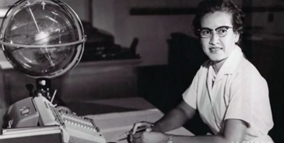
3.5.1 Warm-Up: Mathematician Katherine Johnson
Born in 1918, Katherine Johnson was
always fascinated by numbers.
Graduating from
high school at 14 and from
college at 18, she went on
to become one of the first
African American
mathematicians with the
job title of “computer” at
NASA, where she worked for three decades. As a computer, she personally checked the calculations made by electronic computers. Katherine calculated the launch window for America’s first human space flight. Her calculations were critical to the success of the Apollo Moon landing program and the start of NASA’s Space Shuttle program. In 2015, she received the Presidential Medal of Freedom from President Obama. In its official announcement, the White House cited Katherine’s influence on every major space program from Mercury to the Shuttle Program.
volume 1, pg. 98

Slide 6
What stands out to you the most about Katherine Johnson?
volume 1, pg. 98

Slide 7

Collaboration
volume 1, pg. 99

Slide 8

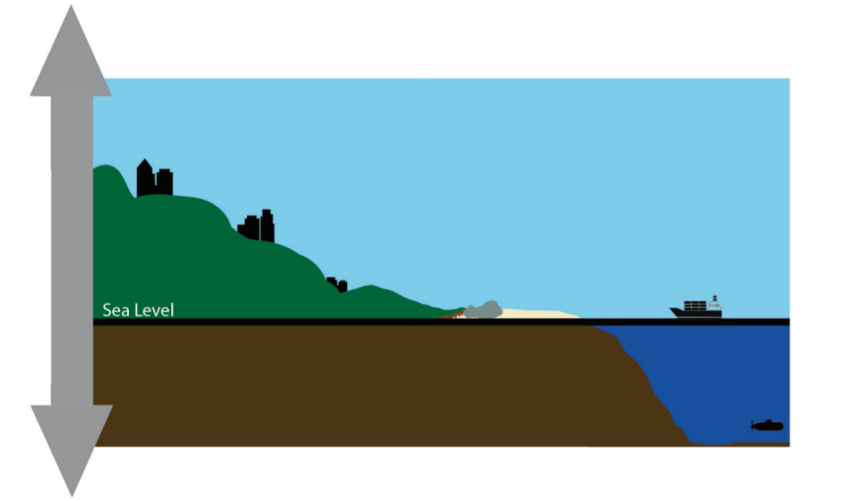
3.5.2 Collaboration: Exploring Elevation
The picture shows different locations relative to sea level.
Describe how the picture can be used to explain the word elevation.
volume 1, pg. 99

Slide 9
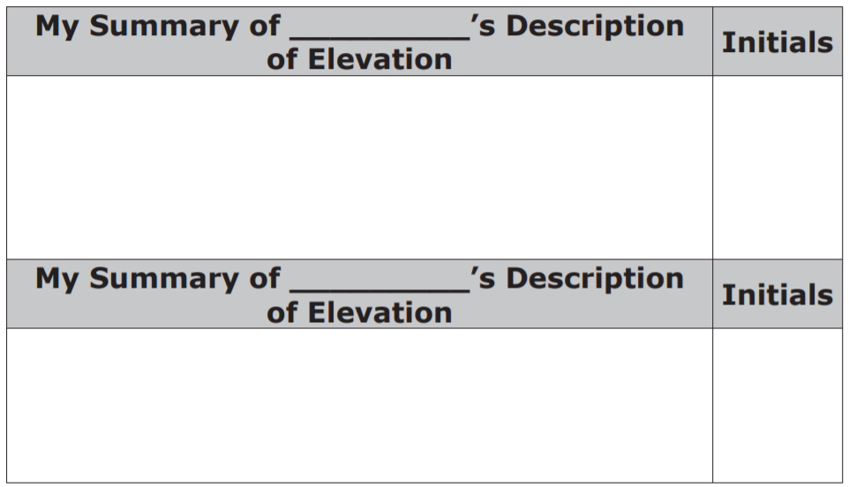
Ask two classmates for their description of the word elevation. Write their description in the table. You are the only person who should write in the first column of the table. Have your classmate initial next to your summary of their description stating that your summary is correct.
volume 1, pg. 99

Slide 10
Using the picture, name one thing that is below sea level.
4. Name one thing that is above sea level.
volume 1, pg. 99

Slide 11

Guided Instruction
volume 1, pg. 100

Slide 12
3.5.3 Guided Instruction: Positive and Negative Values in the Real World
Elevation is the vertical distance a location or object is from a given level, such as sea level.
Elevation is represented using positive and negative values.
If sea level is equivalent to an elevation of 0 units, then what type of value is an elevation that is below sea level?
volume 1, pg. 100

Slide 13

2. Write each situation as an integer. Plot it on the vertical number line.
A hiker is 37 feet above sea level.
A diver is 19 feet below sea level.
How are these two integers related?
What does 0 represent in this situation?
volume 1, pg. 100

Slide 14
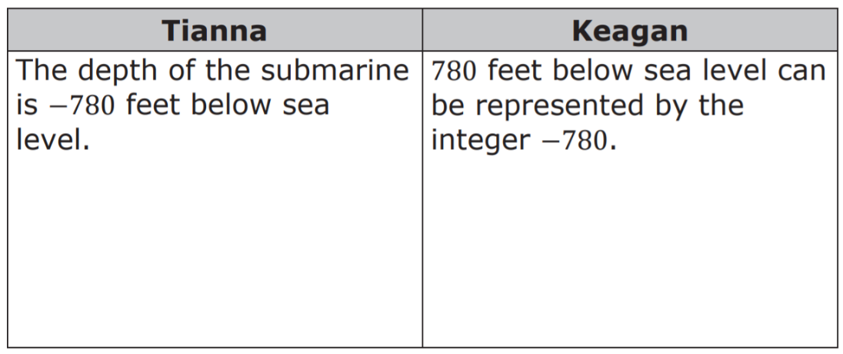
3. Samuel L. Gravely, Jr. pioneered the way with a plethora of firsts for African Americans in the military. Gravely was the first African American Navy Vice Admiral, first African American to command a Navy warship, first African American to command a warship during combat, first African American to command a Navy fleet, and first African American to obtain Flag Rank in the military. If the Navy fleet included a submarine that was submerged 780 feet below sea level, which students’ interpretation of the situation is correct? Circle the name of the student with the correct answer. For any statement that has an error, write a corrected statement.
volume 1, pg. 100

Slide 15
A bank deposit is the amount of money a person gives the bank for safekeeping in their account.
A bank withdrawal is the amount of money removed from a bank account.
An expense is a cost or the amount of money spent.
volume 1, pg. 100

Slide 16
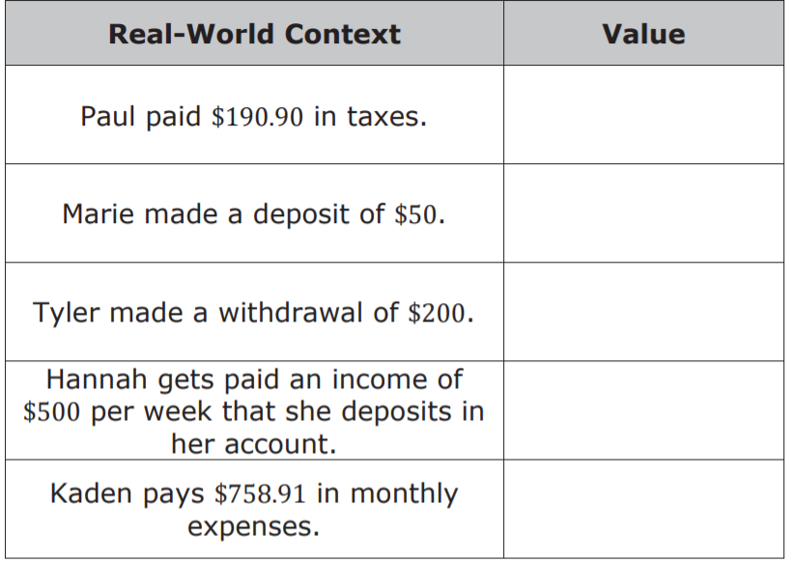
4. The following people have money in their bank accounts. Determine the positive and negative values that represent the effect each situation has on their account balance.
volume 1, pg. 101

Slide 17
Collaboration
volume 1, pg. 101

Slide 18
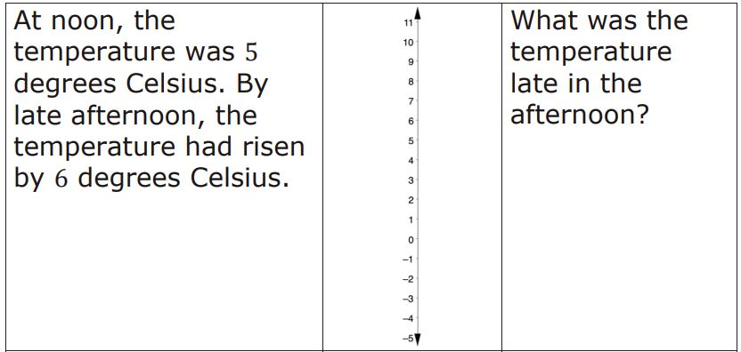
3.5.4 Collaboration: Above or Below Zero
Represent each change in temperature on the number line. Answer the question for each situation.
volume 1, pg. 101

Slide 19
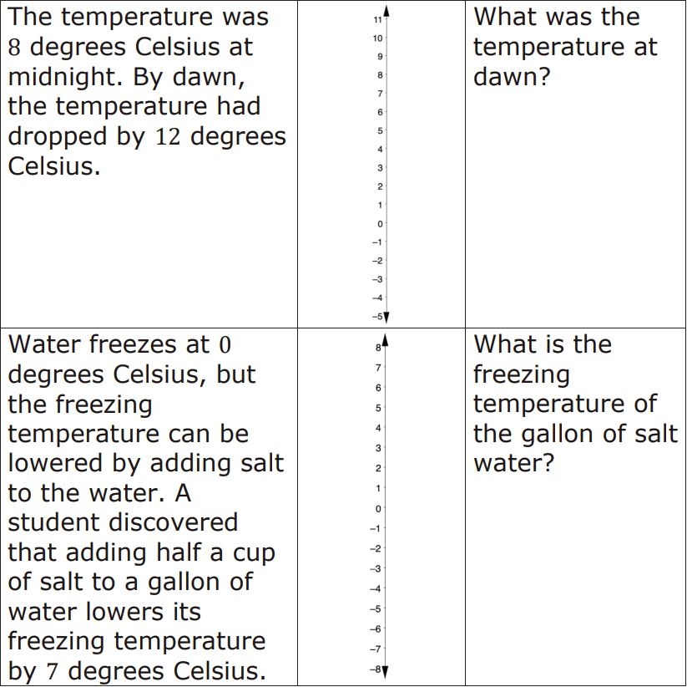
volume 1, pg. 101

Slide 20
Numbers below 0 are useful in contexts other than temperature.
2. With your partner, discuss and list other examples where numbers below zero can be used to represent a situation.
volume 1, pg. 102

Slide 21

Try It
volume 1, pg. 102

Slide 22

3.5.5 Try It: Representing the Real World With Positive and Negative Values
In a bank account, every time money is added or taken out of the account, a new balance is calculated. What does each of the following mean?
an account balance of −$23.56
b. an account balance of $143.21
c. an account balance of $0
volume 1, pg. 102

Slide 23
2. The change in position of the ball during each play of a football game is measured in yards.
What integer best represents a gain of 5 yards?
b. What integer best represents a loss of 15 yards?
c. What does the number 0 represent in this context?
d. Plot all three values on the number line.
volume 1, pg. 103

Slide 24
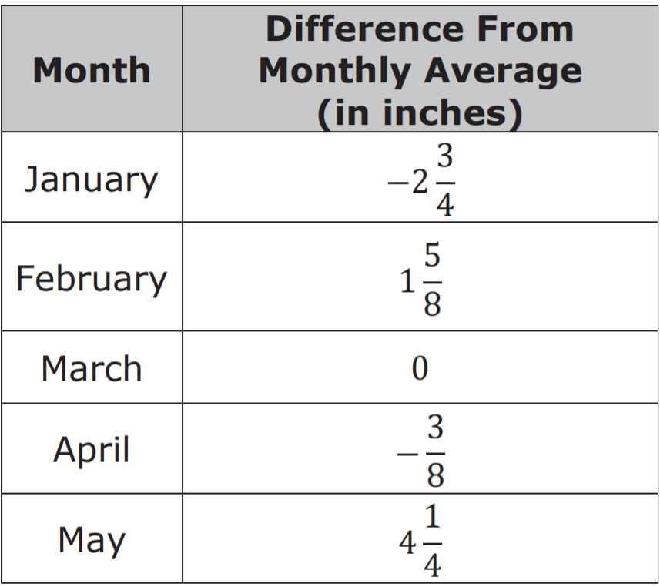
The average monthly rainfall for a city was calculated based on records kept over the past 50 years. The chart shows the difference between the average monthly rainfall and the rainfall amount this year for these months.
volume 1, pg. 103

Slide 25
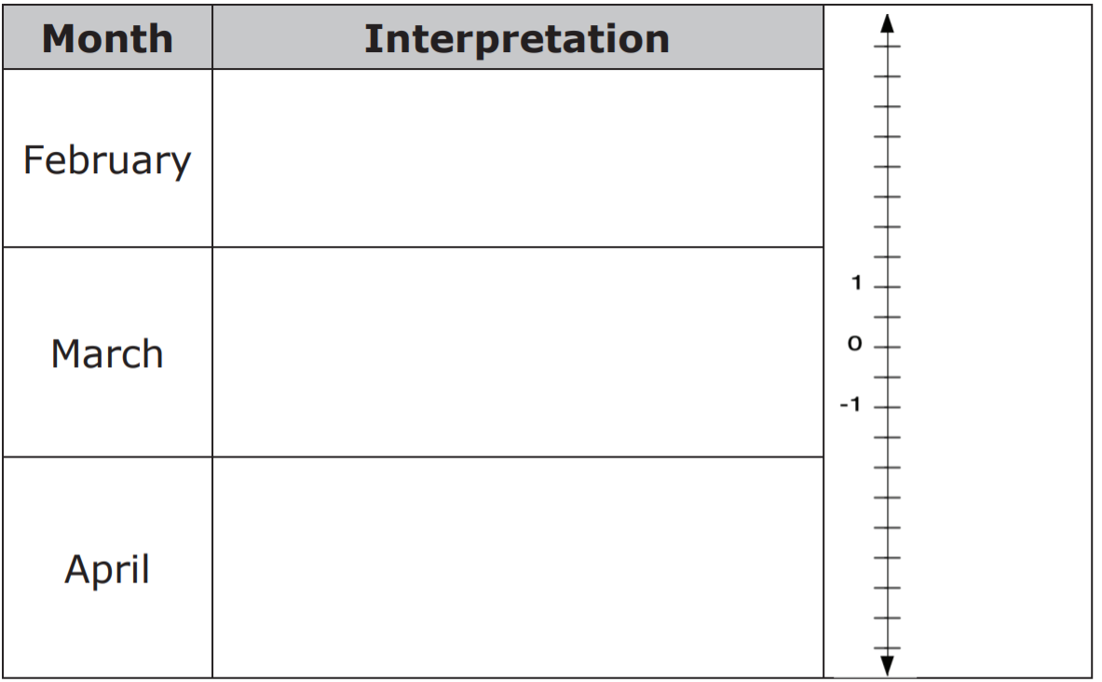
Explain what the value in the chart means for the
following months in the context of this problem. Then,
plot and label each month’s value on the number line.
volume 1, pg. 103

Slide 26

Your Turn
volume 1, pg. 104

Slide 27
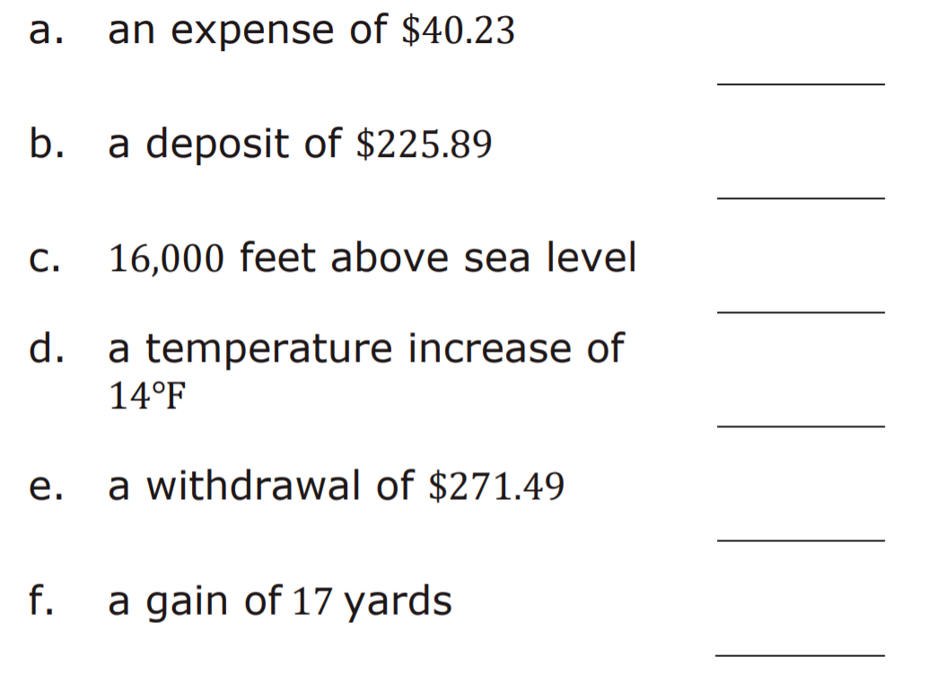
3.5.6 Your Turn!
1. Write a value that represents each description.
volume 1, pg. 104

Slide 28
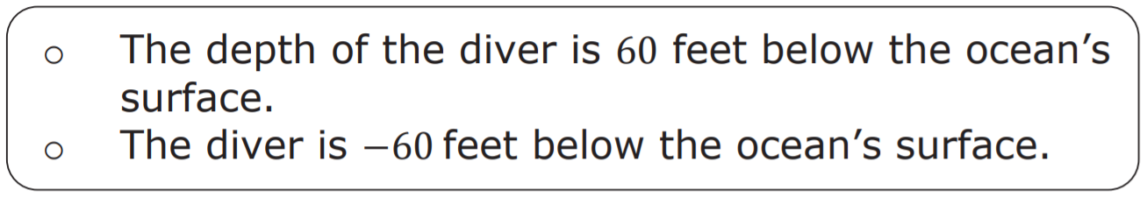
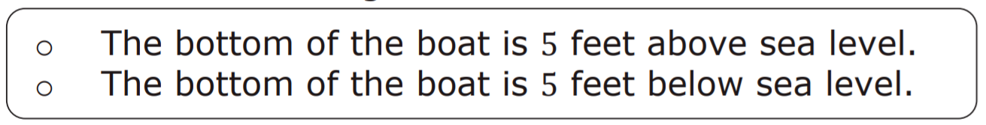
2. Read each statement and select the correct description of each situation.
a. A diver is 60 feet below the surface of the ocean.
The elevation of the bottom of a boat with respect to sea level is given as −5 feet.
volume 1, pg. 104

Slide 29

Wrap-Up
volume 1, pg. 104

Slide 30
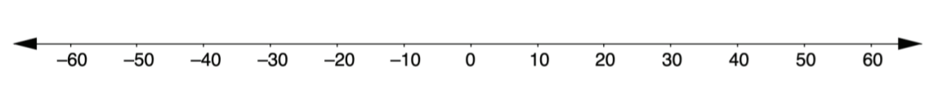
3.5.7 Wrap-Up: Ticket Out the Door
Keisha observes that one location is 55.2 feet above sea level and another is 46.8 feet below sea level.
What rational number represents a location of 55.2 feet above sea level?
What rational number represents a location of 46.8 feet below sea level?
Plot and label each rational number on the number line.
What does zero represent in this situation?
volume 1, pg. 104

